Slide 1
Academic/Examination Rules & Student Counselling Interface
Notes:
Mentor: A Mentor is an experienced adviser and counselor who shall assist the students who are slow learners to enhance their academic performance by identifying the learning difficulties faced by these students and provide them with the remedial solutions. With aim to ensure a healthy exchange of consultation, this policy serves as a roadmap to oversee development, implementation and evaluation of the purpose.
Need for the Policy
To establish direct relationship between student and mentor to enhance the performance of student.
To guide the students in order to enhance their personal and academic growth.
To establish the communication with parent to inform the academic performance and absence rate of student.

Slide 2
ACADEMIC YEAR
LPU calendar is divided into two Terms and one summer term.
For example Year 2020-21 will have
Autumn Term (August to December), Term ID will be 20211.
Spring Term (January to May), Term ID will be 20212.
Summer Term (June to July), Term ID will be 2021W.
-> Summer Term is a condensed form of regular term, which is helpful for students to clear their pending backlogs in short duration

Slide 3
ATTENDANCE MARKS
Marks for attendance would be awarded in a course as per the following (Except school of Agriculture, where ICAR conditions are applied)
It is mandatory for a student to have a minimum of 75% attendance in an individual course to earn marks for attendance in that course.
Attendance %
Marks
90% or more
5
85% or more but less than 90%
4
80% or more but less than 85%
3
Less than 80%
2

Slide 4
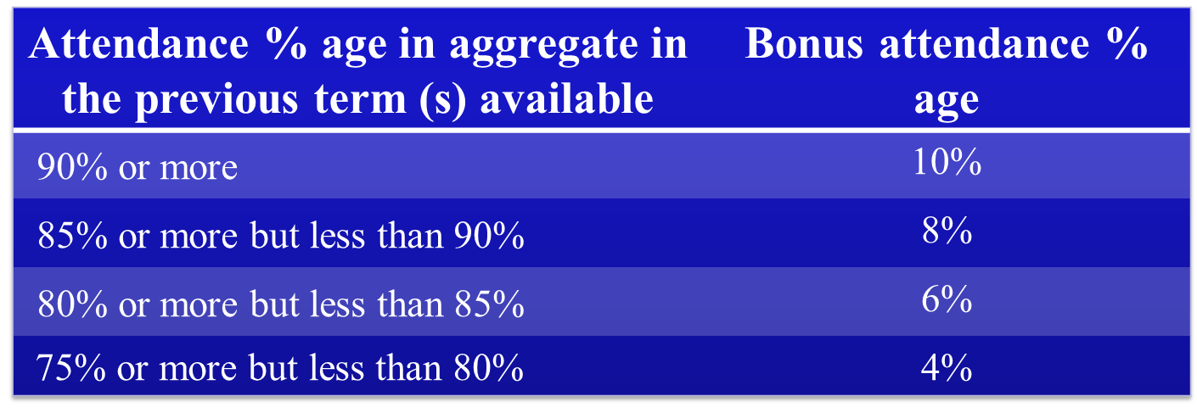
Bonus Attendance
Bonus Attendance is provided to a student whose attendance in the current term is less than 75%. So, he can appear in his End Term Examination (ETE).

Slide 5
Bonus Attendance For Freshmen
For Freshmen, Aggregate attendance percentage will be calculated separately for ‘before Mid Term’ and ‘after Mid Term’ periods.
The maximum of two (before or after MTT) will be considered in bonus.
The double of maximum is added in the aggregate attendance.
The student is subjected to a maximum condoning of 10% in a term.

Slide 6
S. No.
Freshmen Term 1
Student 1
Student 2
A
Aggregate attendance at the end of Term 1
72%
62%
B
Aggregate attendance Before Mid Term in Term 1
76%
60%
C
Bonus Attendance
4%
0%
D
Aggregate attendance After Mid Term in Term 1
68%
64%
E
Bonus Attendance
0%
0%
F
Maximum of two
4%
0%
G
Double of the Maximum Bonus attendance % age
8%
0%
H
New Attendance %
72+8= 80%
62+0= 62%
I
Allowed
Yes
No

Slide 7
Bonus Attendance For Continuing Students
The aggregate attendance of the immediate two previous terms will be taken into consideration.
For Annual Program: In the second year, percentage shortage in attendance that may be condoned would be determined by taking double of the aggregate attendance percentage of the immediate previous year.

Slide 8
S. No.
Continuing Student
Student 1
Student 2
A
Aggregate attendance at the end of current Term
70%
62%
B
Aggregate attendance at the end of previous Term
76%
79%
C
Bonus Attendance
4%
4%
D
Aggregate attendance at the end of previous to previous Term
79%
84%
E
Bonus Attendance
4%
6%
F
Sum of the Bonus attendance %age
4+4= 8%
4+6= 10%
G
New Attendance %
70+8= 78%
62+10= 72%
H
Allowed
Yes
No

Slide 9
Student issue : My aggregate attendance is 64 % , What would be my attendance status ? If I will attend 100 % of the remaining classes.
Being personal mentor analyze the Student’s attendance summary after following the link
UMS Navigation -- > Administrative tools -- > Reports -- >Student Attendance -- >Course wise summary
If the attendance details depicts :
Total delivered lectures till date : 324 Total attended till date : 208
208 / 324 = 64 %
Suppose , as per student’s timetable L T P per week are 24 , there are 3 weeks to go.
Lectures pending to be delivered : 72
But there is one holiday on Friday and LTP on Friday is 5
So effective lectures to be delivered = 72-5 = 67
and if the student is ready to attend 67 lectures ,
Final Projected attendance will be {208 + 67 }/ {324+67} = 275 / 391 = 70 %
Still the student is not able to achieve the required mark ie. 75%, Now Bonus Attendance available if any can be checked.

Slide 10
DETENTION
Fully Detained | Partial Detained
Attendance Less than 65% | Attendance between 65-75%
Note: If a student is not meeting the attendance criteria then F grade will be awarded to student in that course.
Advice:
i) Avoid F grades as it will increase the academic & Financial pressure on you.
ii) Avoid detention to complete your degree in the stipulated duration.

Slide 11
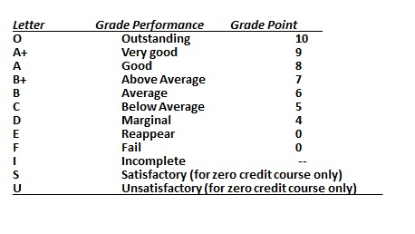
GRADING SYSTEM
R Grade is given in Dissertation/Projects/Trainings
M Grade

Slide 12
Passing Criteria
To obtain a Pass Grade (O, A+, A, B+, B, C, and D) in a course, a student must obtain: A minimum of.
Theory Course | Projects/Training/Dissertation/Capstone
40% marks in the course as a whole (Attendance + CA + MTE + ETE) subject to fulfilling any one of the following conditions: Scoring minimum 30% marks in ETE, or Scoring minimum 30% in ETE and MTE taken together | 50% marks in the course as a whole (Attendance + CA + MTE + ETE ) subject to scoring minimum40% in End Term Examination/Viva Voce.

Slide 13
‘E’ GRADE
In case student is not able to meet the passing condition, ‘E’ grade will be awarded.
To clear ‘E’ grade courses, a student will have the following options:
Option- I : Appear for RE-APPEAR Exam
(if student wants to retain CA + ATTENDANCE) or,
Option – II: RE-REGISTER the course as a backlog course
(if student wants to improve the CA+ ATTENDANCE)
The weightage of the re-appear exam will be equal to weightage of MTT + ETE for that course.
The student may apply for re-appearing in the immediate NEXT FIVE reappear examinations held after the term in which the student has registered the course in which E grade was awarded.
Chance given is equal to chance availed.
If student not able to clear in five attempts it will be automatically converted to ‘G’
Voluntarily student can convert from E TO F

Slide 14
‘F’ GRADE
‘F’ grade will be awarded in three cases:
Case I : Student does not satisfy the attendance requirements for being eligible to appear in the End Term examination.
or
Case II : ‘F’ grade awarded by the Unfair Means Case (UMC) Board .
To clear ‘F’ grade student has to re-register the course and attend classes and appear for all components of evaluation (CA, MTT and ETE).
Fee is 1/10th of total programme fee (without scholarship)
F grade can never be converted to E or G

Slide 15
‘G’ GRADE
Case I : When student is not able of meet the passing criteria after giving the 5 Reappear chances.
Case II : Student voluntarily converts E grade to G grade
Passing criteria in G grade is 40% and Fee is 1/10th of total programme fee (without scholarship)
Attending classes is optional.

Slide 16
Improvement Exam
In case a student after obtaining the Pass Grade, wants to improve his result, he will have two options:
Option 1: Reappear for the course
Option2: Re-register the course

Slide 17
Nomenclature of Term IDs
1718 W
Registration of course as Backlog in Summer Term
1718 S
Registration of course as Backlog in 1st Term
1718 T
Registration of course as Backlog in 2nd Term

Slide 18
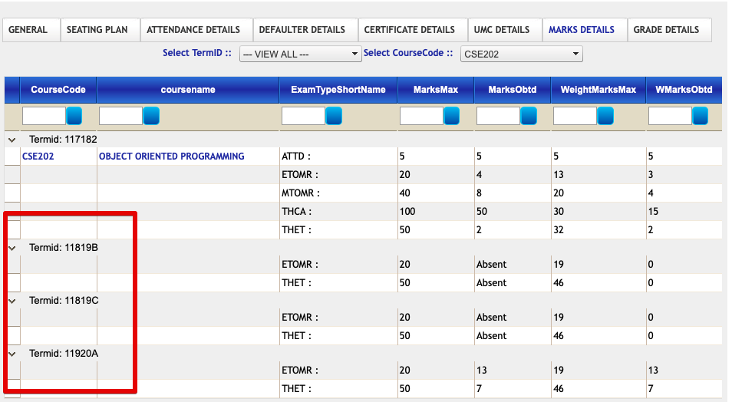
Nomenclature of Term IDs

Slide 19
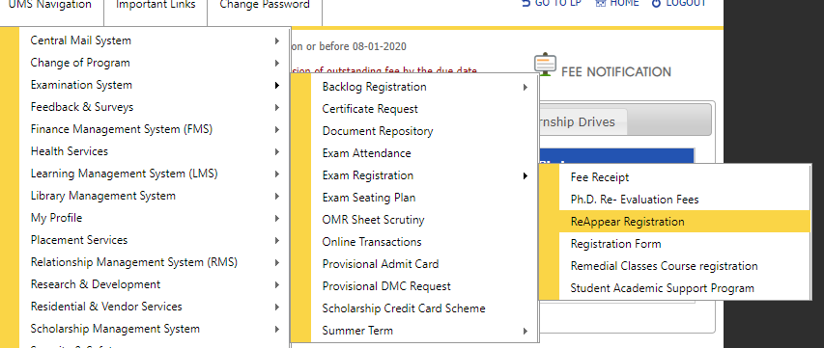
How to register in E- Grade
Student can apply online from his UMS accout
UMS Navigation > Examination > Reappear Registration

Slide 20
Promotion Criteria
Promotion to Next Year:- A student will be promoted to the next year of a programme, if he/she satisfies the following conditions:
After the completion of 1st year:-The student has passed a minimum of forty percent (40%) courses prescribed for the first year of the programme (all the terms of first year taken together).
After the completion of 2nd year:-The student has passed a minimum of fifty percent (50%) courses prescribed in the first two years of the programme (all the terms of First and Second year taken together).
After the completion of 3rd Year and onwards:-The student has passed a minimum of sixty percent (60%) courses prescribed in the first three years of the programme (all the terms of first, second and third year taken together).

Slide 21
Promotion Criteria In Dual Degree
The students of dual degree who choose/opt to ‘continue’ with higher degrees shall be promoted to the higher degree/diploma/certificate subject to fulfillment of the Minimum CGPA of 5.5 for grade based programmes or a minimum percentage of 50% for marks based programmes.
Year Back :-
When student does not clear the prescribed courses as per promotion policy, student is bound to get year back and shall attend the classes of the year from which he/she is not promoted all over again.
➔if the student gets non promoted, he will remain non promoted for a year not for single semester.

Slide 22
Coding used by Examination Division for marking the student status:
Not promoted to higher degree : NH
Temporarily marked absent : TMP
Completed the degree : C or PC
Non Promoted : N
Active : A
Incomplete : I
Maximum duration over : NFT
Semester Skip (Term Off) : S

Slide 23
The following cases may be included under this category: Necessary course of action
Accident/Health Issue
Financial issue
Family/Personal Issue
Joining Late
Not promoted and Not registered
for any course in the current term
Advise the student for Term off / Semester skip
Call the parents and inform them about the courses / Reappear schedule available in the coming term}

Slide 24
TERM OFF
In case if student is not able to attend the current semester due to any of the issues listed below, student should be advised to take TERM OFF:
a. Financial issues
b. Health issues
c. Other family concerns
All courses for the said term will be awarded as M grades and student has to re-register the course as backlog once he joins the university.

Slide 25
Student Counselling Interface

Slide 26
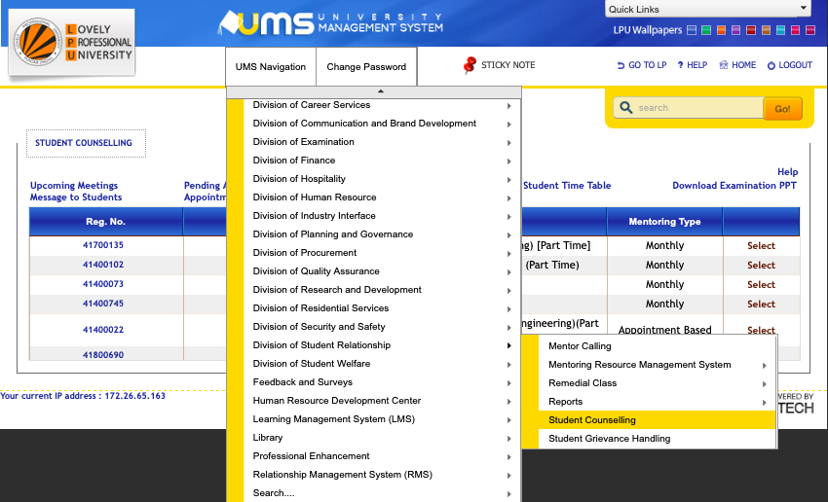
Student Counselling Interface

Slide 27
Student Counselling Interface
Two types of meetings :
1. Monthly meeting(mandatory) 2. Appointment based (student can ask appointment from mentor).
Click on the select option which is showing in front of student name

Slide 28

SCHEDULE MEETING
Fill the details of meeting:
Date:
Time: Free time slots of students are visible now.
Google Meet Link:
*Meeting of any particular month can be conducted in that same month only. It can not be conducted in any “other month”

Slide 29
ATTENDANCE STATUS
Mark Attendance:
Select the relevant option, whether student is Present/Absent/Left/Not in University/Training.

Slide 30
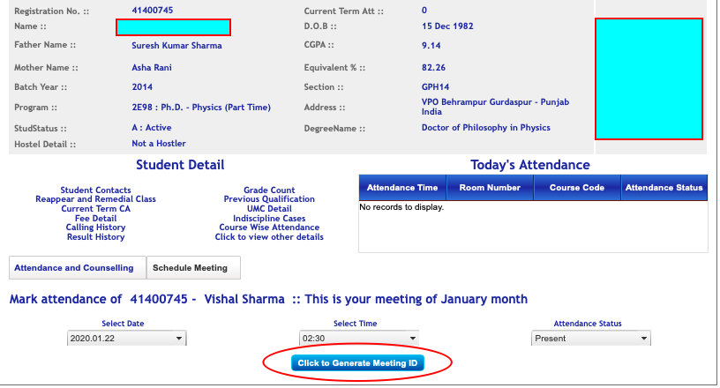
Attendance Status - PRESENT
Once the student is marked “PRESENT”, mentor will the “Click to Generate Meeting ID”.
The meeting id will be sent to student’s UMS “my message”

Slide 31
Enter Meeting ID
Mentor will enter the “Meeting ID” in the given space and click “proceed” to open the meeting agenda.

Slide 32
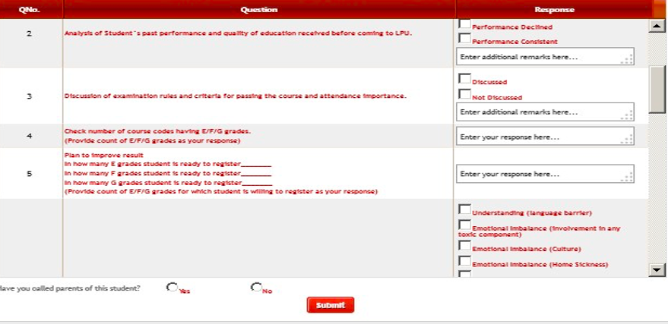
Fill Agenda
Student wise AGENDA should be filled, when the student has been marked PRESENT

Slide 33
Meeting Status-ABSENT
Mentor should wait for 10 mins at least once logged in on “Google Meet”
b. If student doesn’t turn up then mentor should call the student to join the meeting.
c. Lastly Students can be marked “ABSENT” if he/she will not pick up the call..
d. Meeting needs to be scheduled again if student is having attendance.
Meeting Status-LEFT
Mentors are advised to cross check the attendance of the student and parents confirmation must be taken by mentor while marking LEFT.

Slide 34
Meeting Status-Training/Dissertation
If student is on Training/OJT/Duty leave , then this status should be selected by the Mentor and remarks of telephonic conversation should be entered in the given space

Slide 35
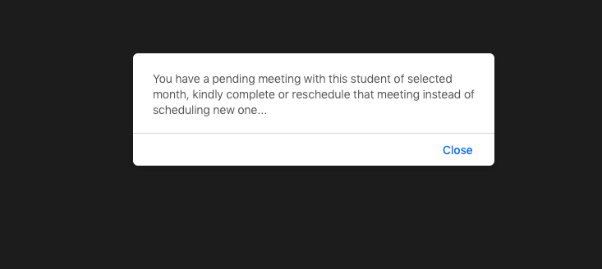
Multiple Schedule
Multiple Schedule of meeting for the same student (without completing the earlier scheduled meeting) can not be punched.
Mentors need to reschedule the already punched meeting slot.

Slide 36
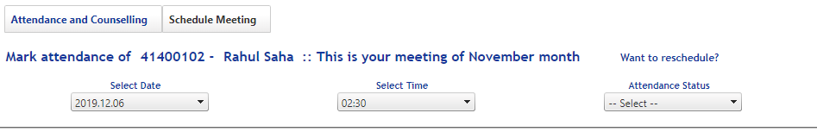
Rescheduling of Meeting
If meeting is scheduled but not held, then need not to schedule new meeting, the already punched meeting can be reschedule.

Slide 37
Other Options on the Interface

Slide 38
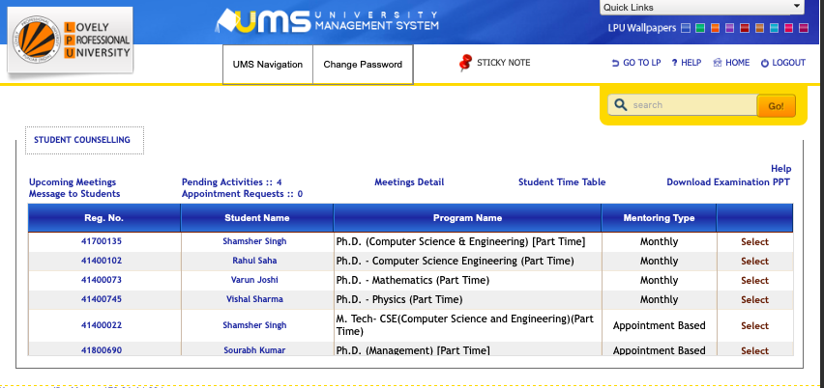
Upcoming Meetings
By clicking on this link MENTOR can view the upcoming meetings scheduled

Slide 39
Pending Activities
By clicking on this link MENTOR can view all the pending meetings month wise.

Slide 40
Meeting Detail
By clicking on this link MENTOR can view, the details of all the meetings held in previous months with the mentee.

Slide 41
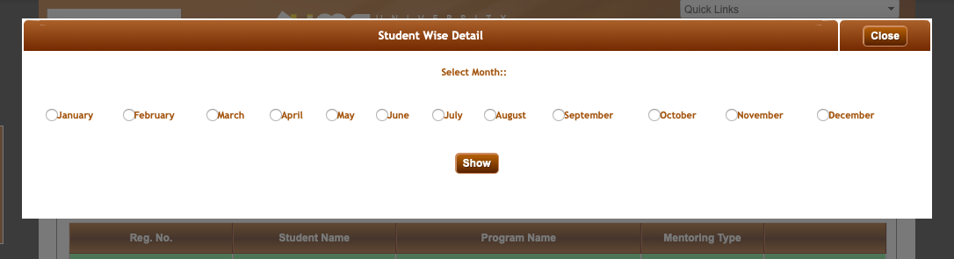
Meeting Detail (Select Month)

Slide 42
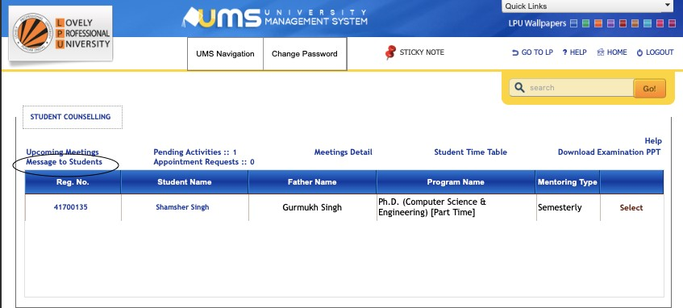
Message for Mentee By Mentor
Mentor can send UMS My message to his/her mentee using the link given

Slide 43
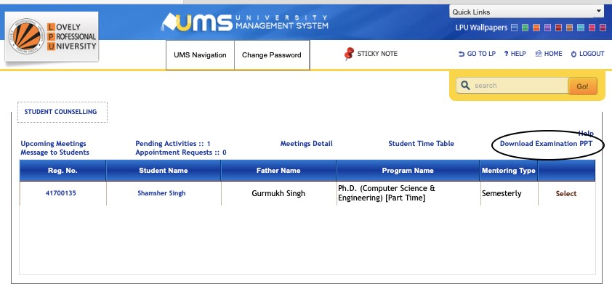
Download Examination PPT
By clicking on this link MENTOR can view the detailed explanation of Academic and Examination rules.

Slide 44
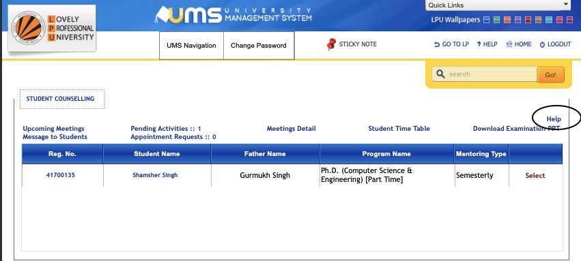
HELP
By clicking on this link MENTOR can view in detail description of all the Attendance Status.

Slide 45
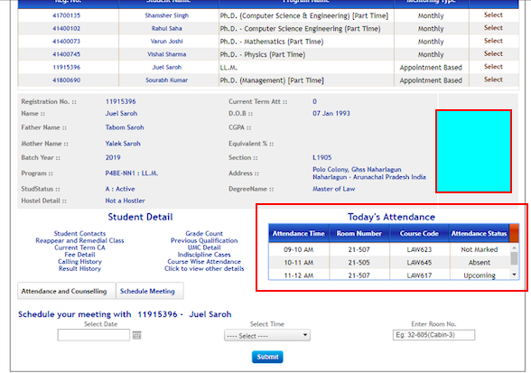
Live Attendance
Current attendance of every lecture is visible in the interface.

Slide 46
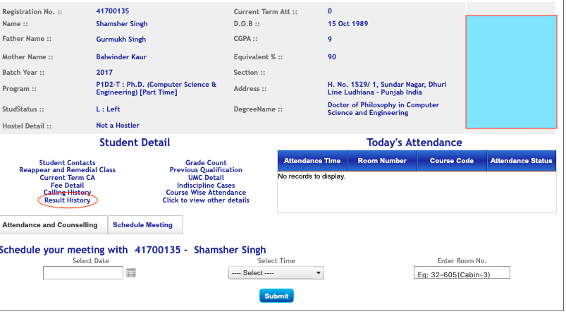
Result History
Result details of student is available i.e
Current CGPA of student.
It will be updated after every month. From this the mentors can check the progress of their mentee every month.

Slide 47
Details of Mentor / HOD/HOS and DSR on Student UMS Landing Page

Slide 48
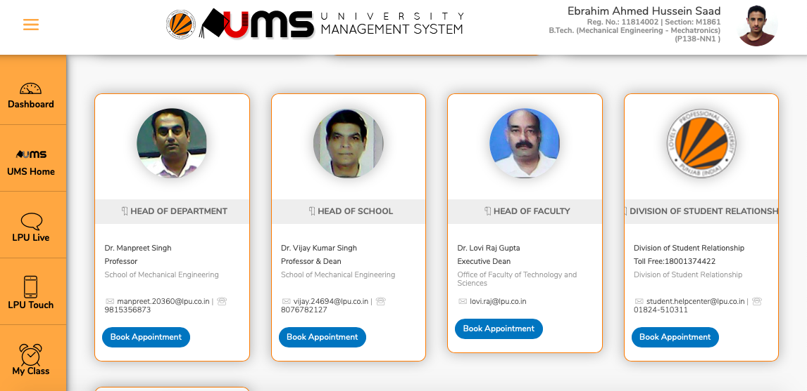

Slide 49
Appointment Request By Mentee
Any mentee may seek an appointment from mentor through UMS.
Mentor has to approve this appointment by clicking on the link given.
Approve the appointment request by providing the details of time and contact number to mentee during their “Free Slots” that are available on interface

Slide 50
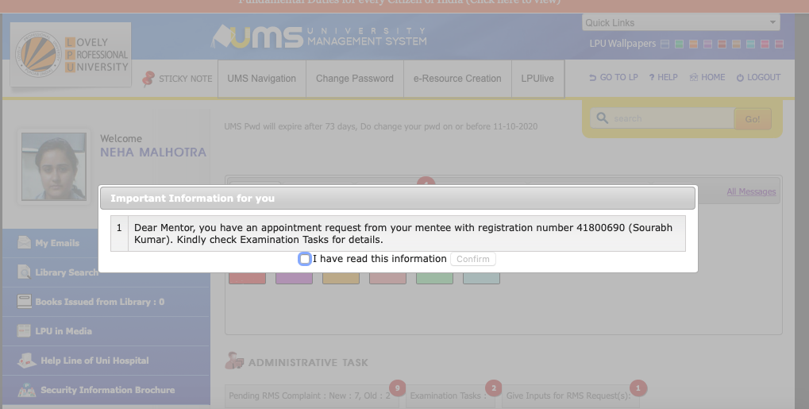
Pop up message to mentor when student book an appointment

Slide 51
Appointment Request By Mentee
Mentor can access the request from Examination Task on UMS home page
Or
Through Student Counselling Interface

Slide 52
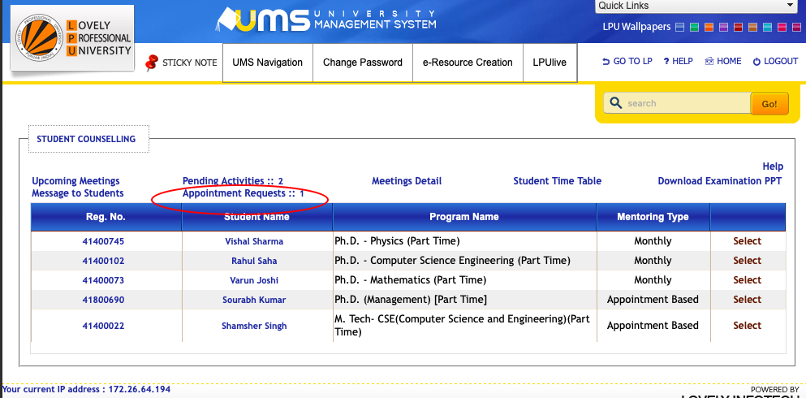
UMS Navigation->Division of Student Relationship->Student Counselling

Slide 53
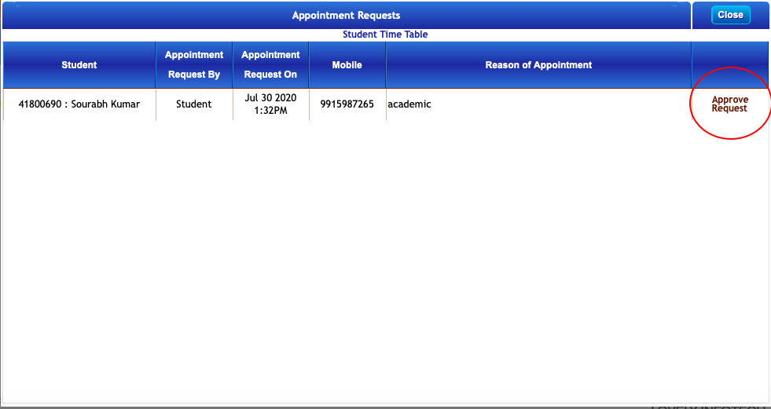
Click on Appointment Request

Slide 54
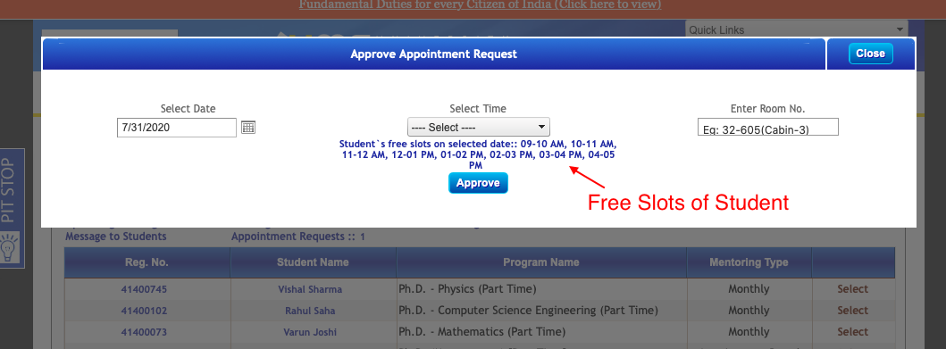
Mentor will mention date and time of appointment (This schedule will be reflected while marking student attendance)

Slide 55
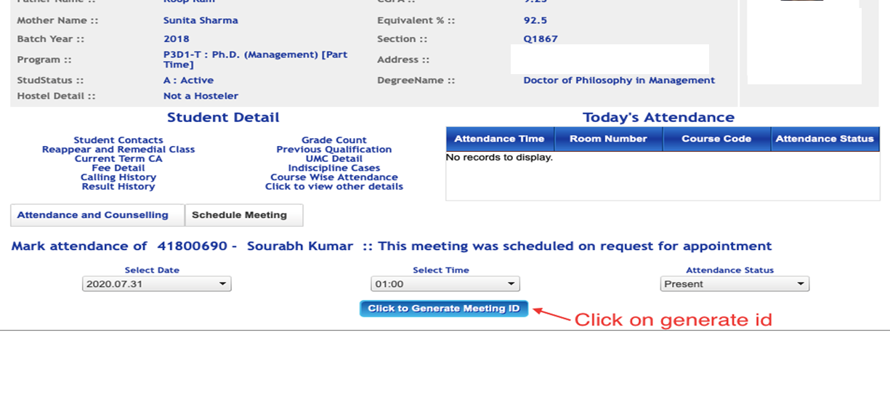
During Appointment, mentor will click on generate meeting id:

Slide 56
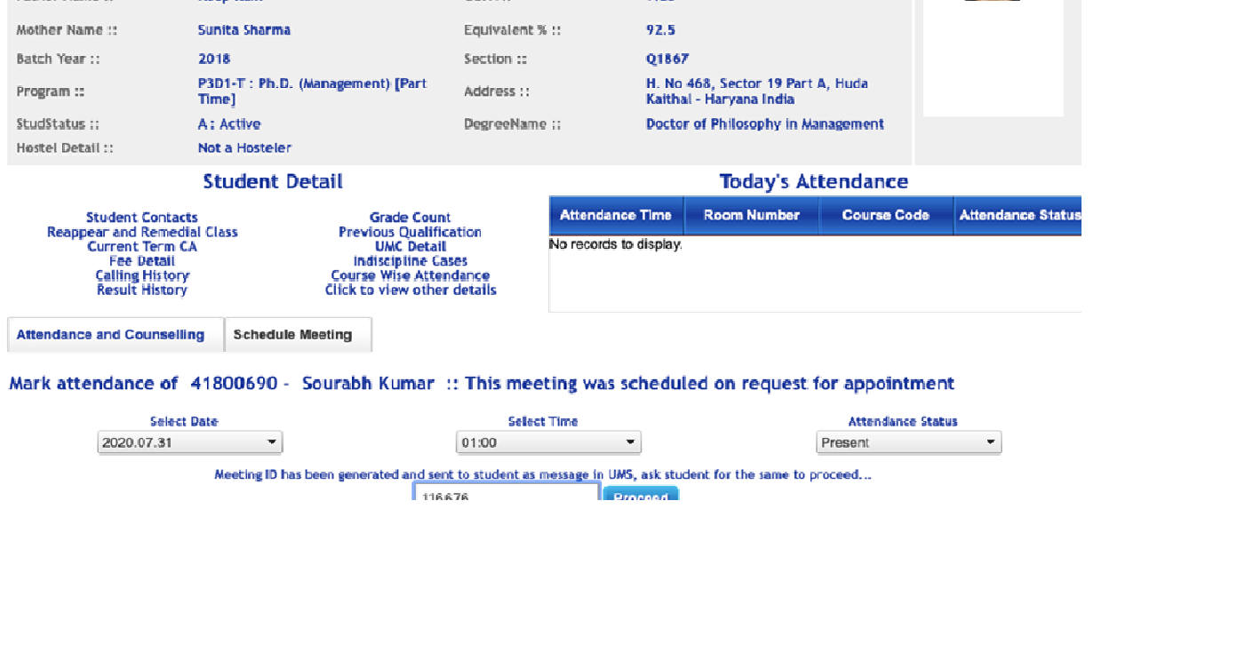
Id to be entered while meeting (this id will become available with the student, when mentor approves the appointment request)

Slide 57
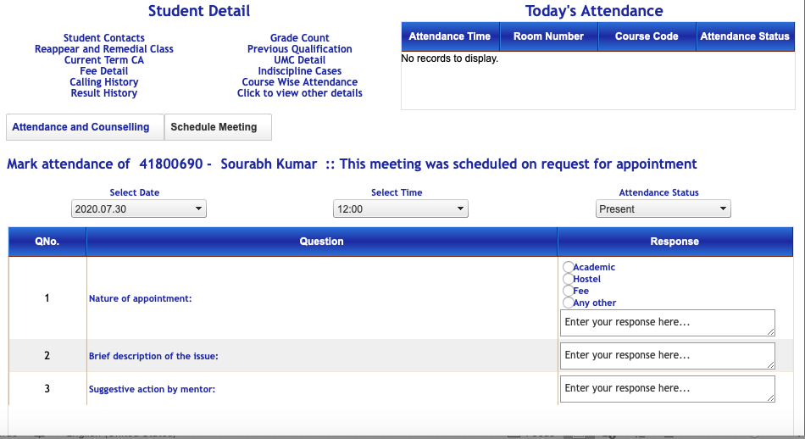
Appointment Agenda

Slide 58
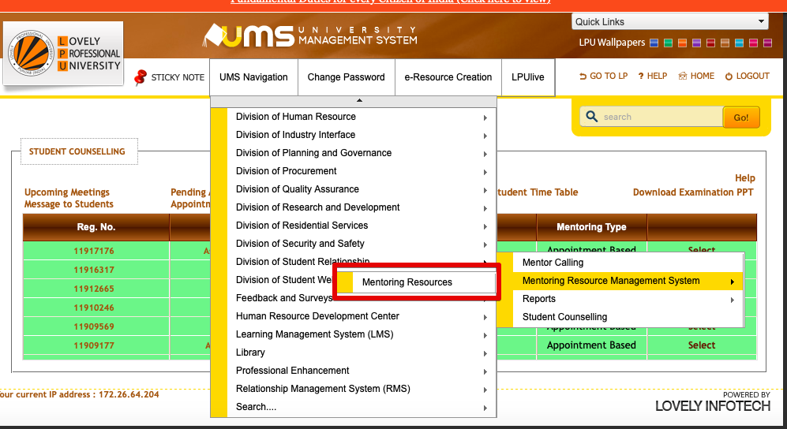
Mentoring Resources

Slide 59
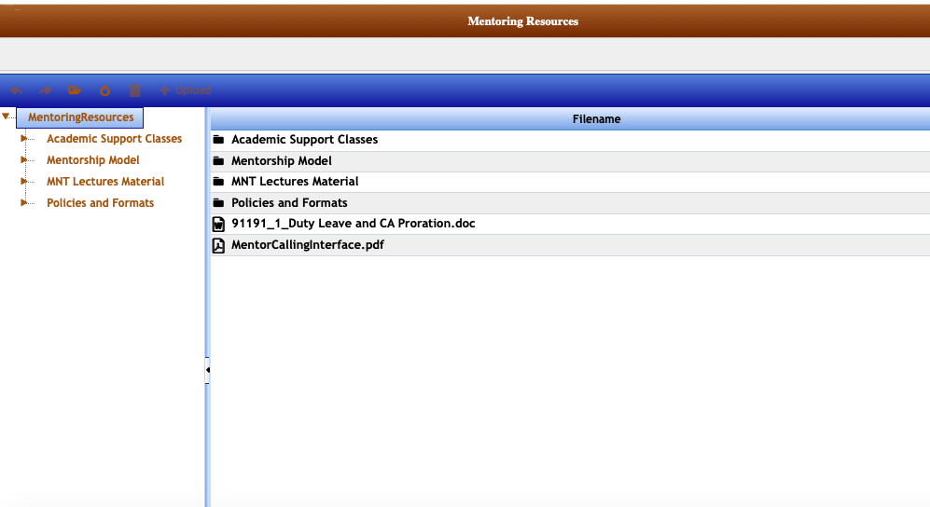
Mentoring Resources

Slide 60
Advice
While calling to parents mentors must verify some details of student like: D.O.B, Address, Details about family members etc. to ensure the authenticity of call.
Mentors must advise the parents not to change their registered contact number and in case they do so, they should get it updated with us through parents@lpu.co.in.

Slide 61
Additional Efforts
Remedial classes.
Tuition Model (SASP)
MNT Lectures for Freshmen

Slide 62


Slide 63


Counseling & Happiness Cell
, guidance and advice
is strictly maintained
Don’t Be Afraid, Seek Help, Come To Us And Live a Happier Life
Free consultation
Confidentiality

Slide 64
If You’ve Got Problems,….We’ve Got Ears!!!!!
Email: counseling.happiness@lpu.co.in - to arrange counseling session
Free online counseling service from - YourDOST. available 24/7, 365 days a year.
You can connect with their experts at any time and receive guidance and support via these quick
links:
1. YourDOST Online chat counseling at bit.ly/YDatLPUChat
2. Book an appointment for Telephonic or Video sessions at bit.ly/YDatLPUBookAppointment
Notes:
Any kind of Stress, Anxiety, Homesickness, adjustment and relationship issues
64

Slide 65
Commonly Raised Issues by mentees

Slide 66
Student issue : My attendance is blocked due to the non payment of fee.
Being a mentor guide the student to pay the fee immediately to get the attendance unblocked .
FRESHMEN : If student shows his/her inability to pay the fee , kindly guide the student to mail at feeinfo@lpu.co.in
Old Student: If student shows his/her inability to pay the fee , kindly guide the student to book an appointment with DSR official. Link for booking appointment with DSR official: https://tinyurl.com/bookyourappoint
Note: We generally do not promote fee extension as students are provided with enough time to deposit the fee , still specific/genuine cases can be forwarded to Division of Student Relationship.

Slide 67
Student issue : My attendance is blocked due to non submission of pending documents .
Being a mentor guide the student to deposit the pending documents to admissions@lpu.co.in
If student shows his/her inability to deposit the same, kindly guide the student to talk to the concerned admission officer for further extension in date .

Slide 68
Student issue : Issues related to MyClass
Guide the student to mail at support.myclasses@lpu.co.in or student can call us at 01824-517450

Slide 69
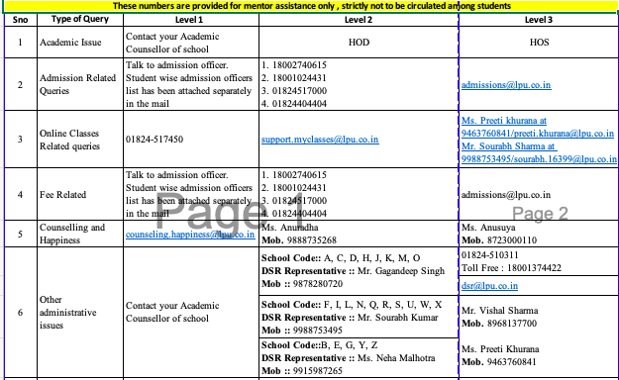
CENTRAL HELPLINE NUMBERS

Slide 70

Division of student relationship
Reach out to us if you have any questions
Block 32 room 100
Email us:
mentorship@lpu.co.in (For Mentors)
student.helpcenter@lpu.co.in (For students)
parents@lpu.co.in (For Parents)

